Slide 1
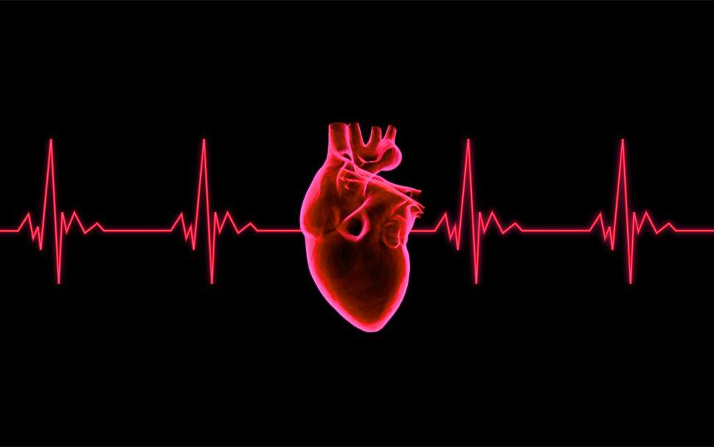
Heart Disease - Prediction

Slide 2
Overview
Database contains 76 attributes, but all published experiments refer to using a subset of 14 of them. In particular, the Cleveland database is the only one that has been used by ML researchers to this date. The "goal" field refers to the presence of heart disease in the patient. It is integer valued from 0 (no presence) to 1(presence).
Attribute Information: > 1. age > 2. sex > 3. chest pain type (4 values) > 4. resting blood pressure > 5. serum cholesterol in mg/dl > 6. fasting blood sugar > 120 mg/dl > 7. resting electrocardiographic results (values 0,1,2) > 8. maximum heart rate achieved > 9. exercise induced angina > 10. oldpeak = ST depression induced by exercise relative to rest > 11. the slope of the peak exercise ST segment > 12. number of major vessels (0-3) colored by fluoroscopy > 13. thal: 3 = normal; 6 = fixed defect; 7 = reversible defect
Experiments with the Cleveland database have concentrated on simply attempting to distinguish presence (values 1,2,3,4) from absence (value 0).
Our Goal : Find any other trends in heart data to predict certain cardiovascular events or find any clear indications of hear health.

Slide 3
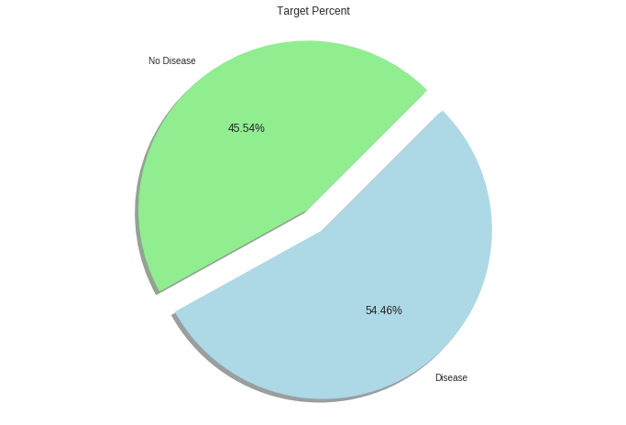
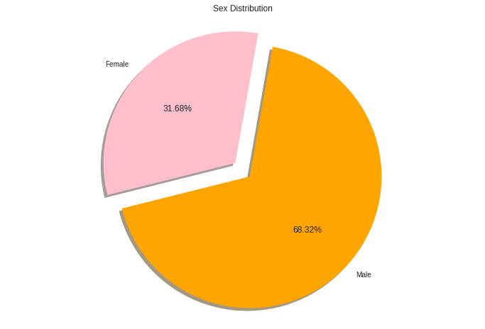
Overall Target and Sex Distribution
Shows Overall Target Distribution and Sex Distribution:
Targets are almost Balanced.
Sex Distribution shows majority male.

Slide 4
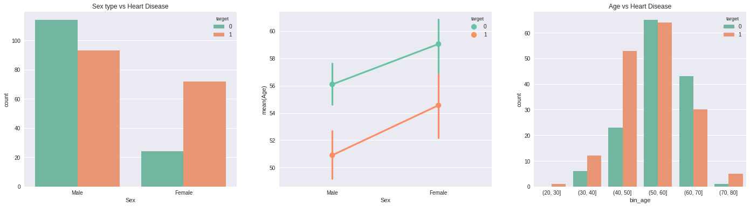
How Sex Type and Age is associated with Heart Disease
Figure1 : shows that Male are more likely to get heart disease
Figure 2 : shows that mean age for female with heart disease is 54 and male with heart disease is 51
Figure 3 : shows Ages between 40 to 70 are more likely to have heart disease

Slide 5
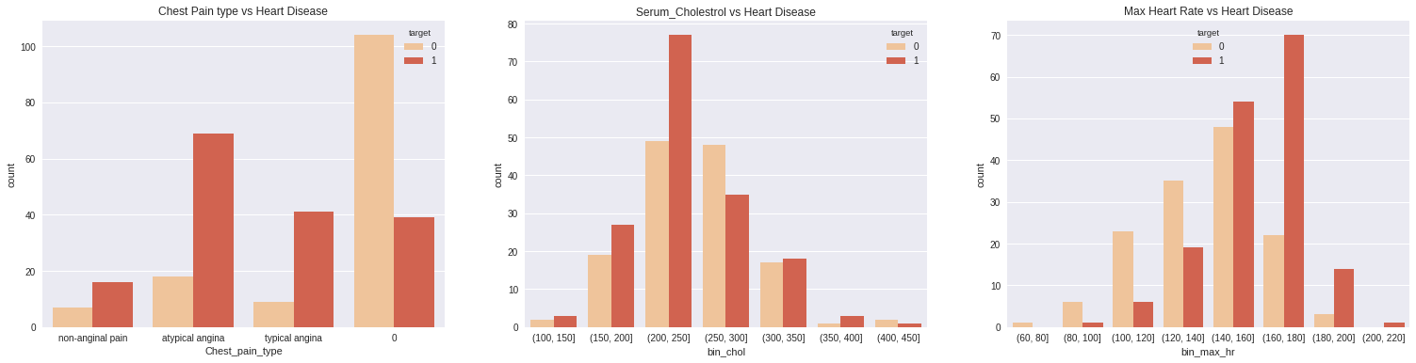
What attributes Increases the occurrence of Heart Disease
Figure 1 : Shows chest pain with type atypical angina resulted in more heart disease and people experiencing no chest pain have
Less probability of have heart disease.
Figure 2 : Shows patients having Cholesterol Range between 200 - 300 have more chances of getting heart disease.
Figure 3 : Shows patients having max heart rate between 140 to 180 have more chances of getting heart disease

Slide 6
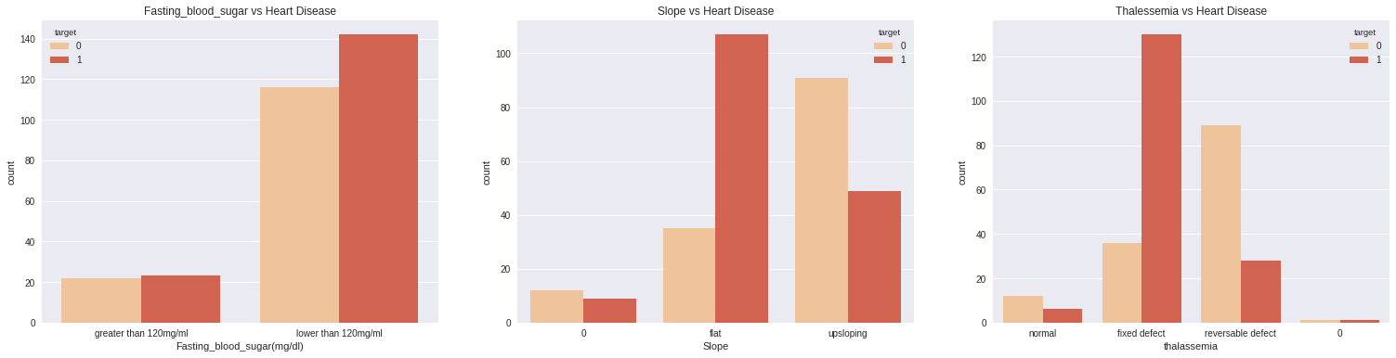
What attributes Increases the occurrence of heart disease
Figure 1 : Shows Blood Sugar level lower than 120mg/ml have more chances of getting heart disease.
Figure 2 : Shows slope attribute with type flat have resulted in heart disease.
Figure 3 : Shows thalassemia attribute with type fixed defect have resulted in heart disease.

Slide 7
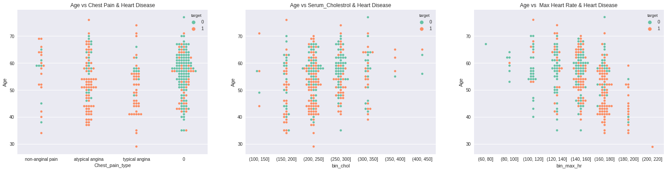
How attributes are associated with distribution of ages
Figure 1 : Shows important insight - Chest pain type makes an important factor for having heart diseases because most
of the cases who are likely to have heart disease are also likely to experience chest pain.
Figure 2 : Cholesterol level 200-250 is more among the age range 40 – 60.
Figure 3 : Max heart rate between 160-180 that have led to heart disease are more likely to occur for age group of 40-50.

Slide 8
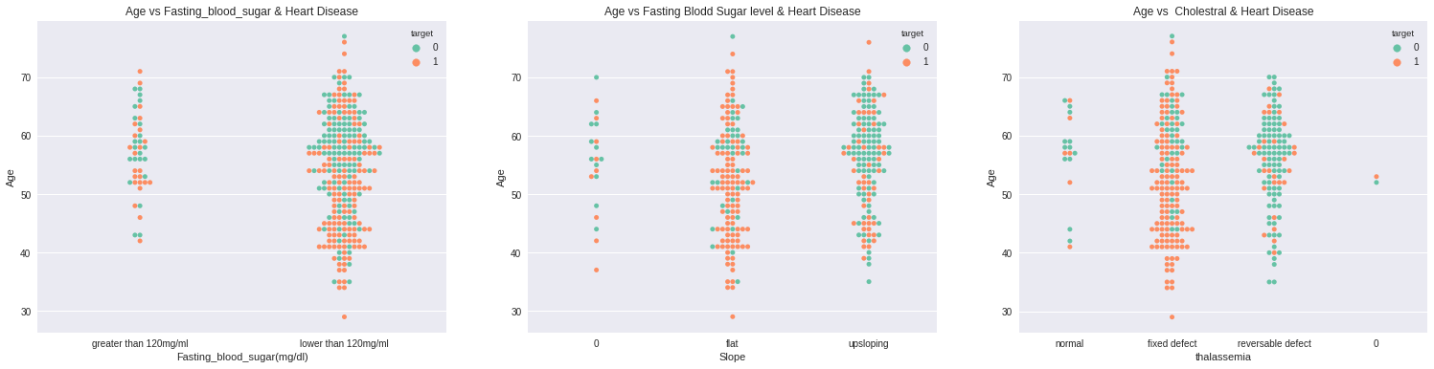
How attributes are associated with distribution of ages
Figure 1 : Shows Important Insight - Most of our observation shows Blood sugar level lower than 120mg/ml and
Is more between age groups of 50 – 60.
Figure 2 : Distribution of slope type with ages.
Figure 3 : Shows Important Insight - Thalassemia type of fixed defect that have led to heart disease are more likely to
occur for age group of 40-55.

Slide 9


Slide 10
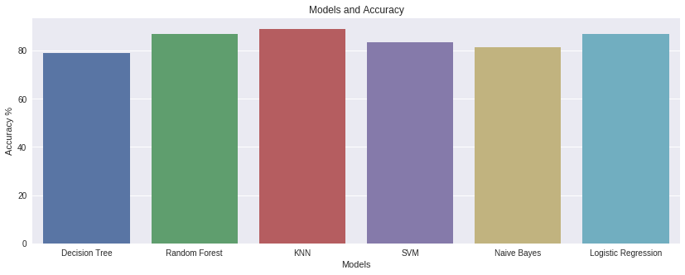
Algorithms used for creating Models
Decision Tree: 79.12% - Performed with default parameters and using GridsearchCV
Random Forest: 86.81% - Performed with default parameters and using RandomizedsearchCV
K-Nearest Neighbors: 89.01% - Performed with default parameters and using RandomizedsearchCV
Support vector machine: 83.51% - Performed with default parameters and using GridsearchCV
Naïve Bayes: 81.31% - Performed with default parameters
Logistic Regression: 86.81% - Performed with default parameters and using GridsearchCV

Slide 11
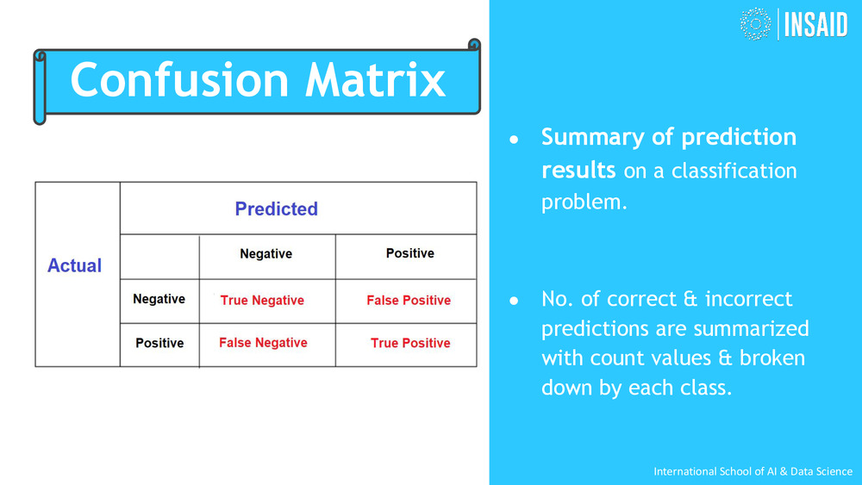
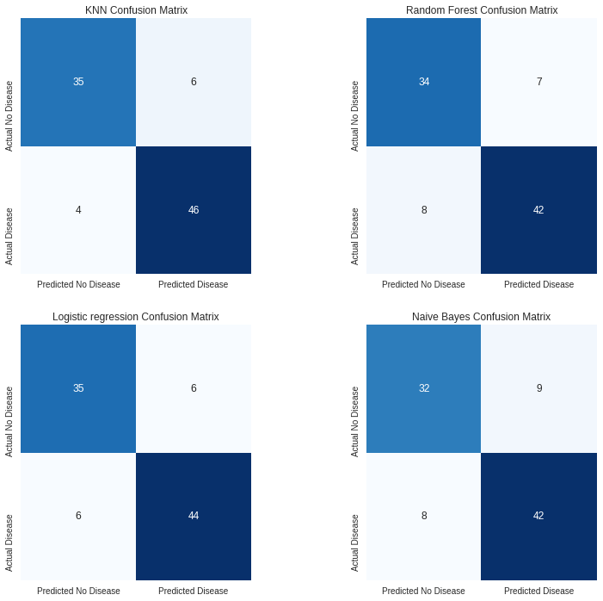
Confusion Matrix for top models

Slide 12
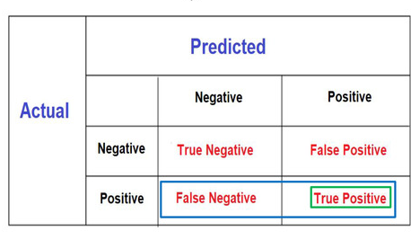
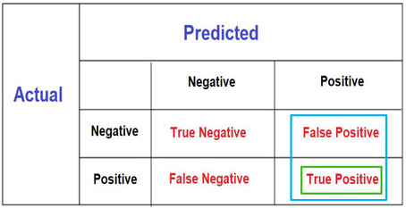
Precision and Recall Score
KNN
Precision score: 0.88
Recall score: 0.92
Random Forest
Precision score: 0.85
Recall score: 0.84
Logistic regression
Precision score: 0.88
Recall score: 0.88
Naive Bayes
Precision score: 0.82
Recall score: 0.84
Recall
Precision
Focuses on false -ve
Focuses on false +ve
Our major goal here is to achieve low False –ve cases
As it may detect a patient having heart disease with no
heart disease.
Hence KNN model has highest precision and recall score.

Slide 13
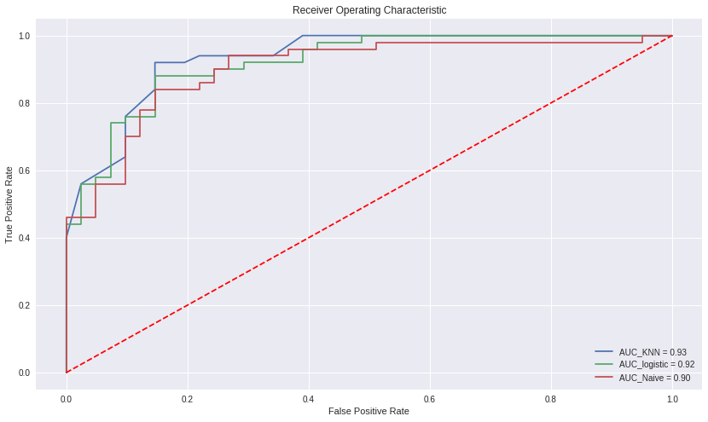
Evaluating using ROC_AUC Curve for the top 3 models
0.90 - 1.00 = excellent
0.80 - 0.90 = good
0.70 - 0.80 = fair
0.60 - 0.70 = poor
0.50 - 0.60 = fail
KNN model Performs good

Slide 14
Conclusion
This dataset seems to be small by today's standards. However, it has allowed us to create a simple model and then use various machine learning explain ability tools and techniques to peek inside.
Most of Attributes were good factors in the model. However each attribute can be analysed in depth to find out what really causes heart disease!
Machine learning has a greater and greater role in health care.

